Slide 1

Semester Project Report
on
“RISHI FITNESS CENTER ”
Submitted in partial fulfillment of requirements for the award of degree of Bachelor of Engineering in Computer Science and Engineering.
Submitted To:
Lakshmi Narain College of Technology University, BHOPAL(M.P)
Submitted By:
RISHI KUMAR
LNCBBTCSE092
Under the guidance of:
Prof. SHAILENDRA CHAURASIYA
DEPARTMENT OF COMPUTER SCIENCE AND ENGINEERING
LNCT University, Bhopal, Madhya Pradesh(462002) Session 2021-22

Slide 2

Rishi fitness center
Project Report
Developed & Submitted By:
Name:RISHI KUMAR
1st Semester
Date:-22/02/2022

Slide 3
DECLARATION
I, RISHI CHANDRA hereby declared that this project work
entitled “RISHI FITNSS CENTER”
submitted to LNCT University is original record work done by
me under the supervision and guidance of Prof. SHAILENDRA CHAURASIYA Department of COMPUTER SCIENCE.
Name Of Student
RISHI KUMAR
Enrollment No.
LNCBBTCSE092
Signature of Student
………………………
CONSIGNED BY:
Prof. SHAILENDRA CHAURASIYA
Teacher in Charge
Department of Computer Science
LNCT University B.Tech CSE

Slide 4
ACKNOWLEDGMENT
The success of final outcome of this project required a lot of guidance and assistance from many people and I am extremely fortunate to have got this all along the completions of my project work. Whatever I have done is only due to such guidance and assistance and I would not forget to thank them.
I have taken efforts in this project. However, it would not have been possible without the kind support and help of many individuals. I would like to extend my sincere thanks to all of them.
I am highly indebted to my computer teacher Prof. SHAILENDRA CHAURASIYA for her guidance and constant supervision as well as for providing necessary information regarding the project & also for supporting mein completing this project.
I am thankful to and fortunate enough to get constant encouragement, support and guidance from all teaching staff of Department of computer science which helped us in successfully completing this project.
I would like to express my gratitude towards my parents for their kind co-operation and encouragement which help me in completion ofthis project.
My thanks and appreciations also go to my colleague in developing the project and people who have willingly helped me out with their abilities.

Slide 5
CONTENTS
Overview of HTML/CSS
About this Project
System Requirements
Flow-diagram
Source Code
Sample Outputs
Conclusion

Slide 6
2/24/22, 1:30 AM
Line wrap
view-source:127.0.0.1:5501/index.html
1 <!DOCTYPE html>
2 <html lang="en">
3
4 <head>
5
6
7
8
9
<meta charset="UTF-8">
<meta name="viewport" content="width=device-width, initial-scale=1.0">
<meta http-equiv="X-UA-Compatible" content="ie=edge">
<title>Home| rishi's GYM</title>
<link rel="stylesheet" href="css/home.css">
10 </head>
11
12 <body>
13
14
15
16
17
18
19
20
21
22
23
24
25
26
27
28
29
30
31
32
33
34
35
36
37
38
39
40
41
42
43
44
45
46
47
48
49
50
51
52
53
54
55
56
57
58
59
60
61
62
63
64
65
66
67
68
69
70
71
72
73
74
75
76
77
78
79
80
81
82
83
84
85
86
87
88
89
90
91
92
93
94
95
96
97
98
99
100
101
102
103
<!-- header starts -->
<header>
<div id="logo">
<a href="index.html">RISHI'S GYM </a>
</div>
<nav>
<ul>
<li class="active"><a href="">Home</a></li>
<li><a href="contact.html">Contact Us</a></li>
</ul>
</nav>
</header>
<!-- header end -->
<!-- intro section starts from here -->
<section id="intro">
<div class="intro-text">
<h2>
Professional Fitness Training &amp;Jumba centre
<h3>The Best Fitness trainer For You</h3>
</h2>
</section>
<!-- intro section ends -->
<!-- welcome section starts -->
<section id="welcome">
<h2>Welcome to our Fitenss Centre</h2>
<p> </p>
<div class="services-container">
<div class="services">
</div>
<div class="services">
<h3>Motivate</h3>
<p> 1>DRESS FOR A WORKOUT,EVEN IF YOU ARE NOT FEELING UP TO IT.
<br> 2>MAKE A COMMITMENT WITH A FRIEND'S.
<br> 3>MAKE A PLAN.
<br> 4>MAKE A GOODg MINDSATE WHENEVER YOU ENTER IN A GYM.
</p>
</div>
<div class="services">
<h3>Trainings</h3>
<p> WE CAN PROVIDE A BEST FACULTIES TO TRAIN. WE CAN TRAIN ALL THE TYPE OF FITTNESS WORK. IN OUR GYM WE CAN PROVIDED DIFFERNT TYP
<br>1>rhythmic
<br>2>balance beam
<br>3>vault
<br>4>un even bars
<br>5>parrel bars
<br>6>pommel horse
<br>7>trampoline
<br>8>high bar
<br>9>still gym
<BR>10>BODY BUILDIG
</p>
</div>
</div>
<div class="work-container">
<div class="work one">
<div class="work-title">
<h3>Body Building</h3>
</div>
</div>
<div class="work two">
<div class="work-title">
<h3>Fitenss</h3>
</div>
</div>
<div class="work three">
<div class="work-title">
<h3>Jumba</h3>
</div>
</div>
</div>
</section>
<!-- end osf the welcome section -->
<!-- blog section starts -->
</div>
<div class="article-text">

Slide 7
2/24/22, 1:30 AM
view-source:127.0.0.1:5501/index.html
104
<p>
105
106
107
108
109
</div>
@designed by RISHI CHANDRA
</footer>
110 <!-- Code injected by live-server -->
111 <script type="text/javascript">
112
113
114
115
116
117
118
119
120
121
122
123
124
125
126
127
128
129
130
131
132
133
134
135
136
137
138
139
140
141
142
143
144
145
146
// <![CDATA[ <-- For SVG support if ('WebSocket' in window) {
(function () {
function refreshCSS() {
var sheets = [].slice.call(document.getElementsByTagName("link")); var head = document.getElementsByTagName("head")[0];
for (var i = 0; i < sheets.length; ++i) { var elem = sheets[i];
var parent = elem.parentElement || head; parent.removeChild(elem);
var rel = elem.rel;
if (elem.href && typeof rel != "string" || rel.length == 0 || rel.toLowerCase() == "stylesheet") { var url = elem.href.replace(/(&|\?)_cacheOverride=\d+/, '');
elem.href = url + (url.indexOf('?') >= 0 ? '&' : '?') + '_cacheOverride=' + (new Date().valueOf());
}
parent.appendChild(elem);
}
}
var protocol = window.location.protocol === 'http:' ? 'ws://' : 'wss://';
var address = protocol + window.location.host + window.location.pathname + '/ws'; var socket = new WebSocket(address);
socket.onmessage = function (msg) {
if (msg.data == 'reload') window.location.reload(); else if (msg.data == 'refreshcss') refreshCSS();
};
if (sessionStorage && !sessionStorage.getItem('IsThisFirstTime_Log_From_LiveServer')) { console.log('Live reload enabled.');
sessionStorage.setItem('IsThisFirstTime_Log_From_LiveServer', true);
}
})();
}
else {
console.error('Upgrade your browser. This Browser is NOT supported WebSocket for Live-Reloading.');
}
// ]]>
147 </script></body>
148
149 </html>

Slide 8
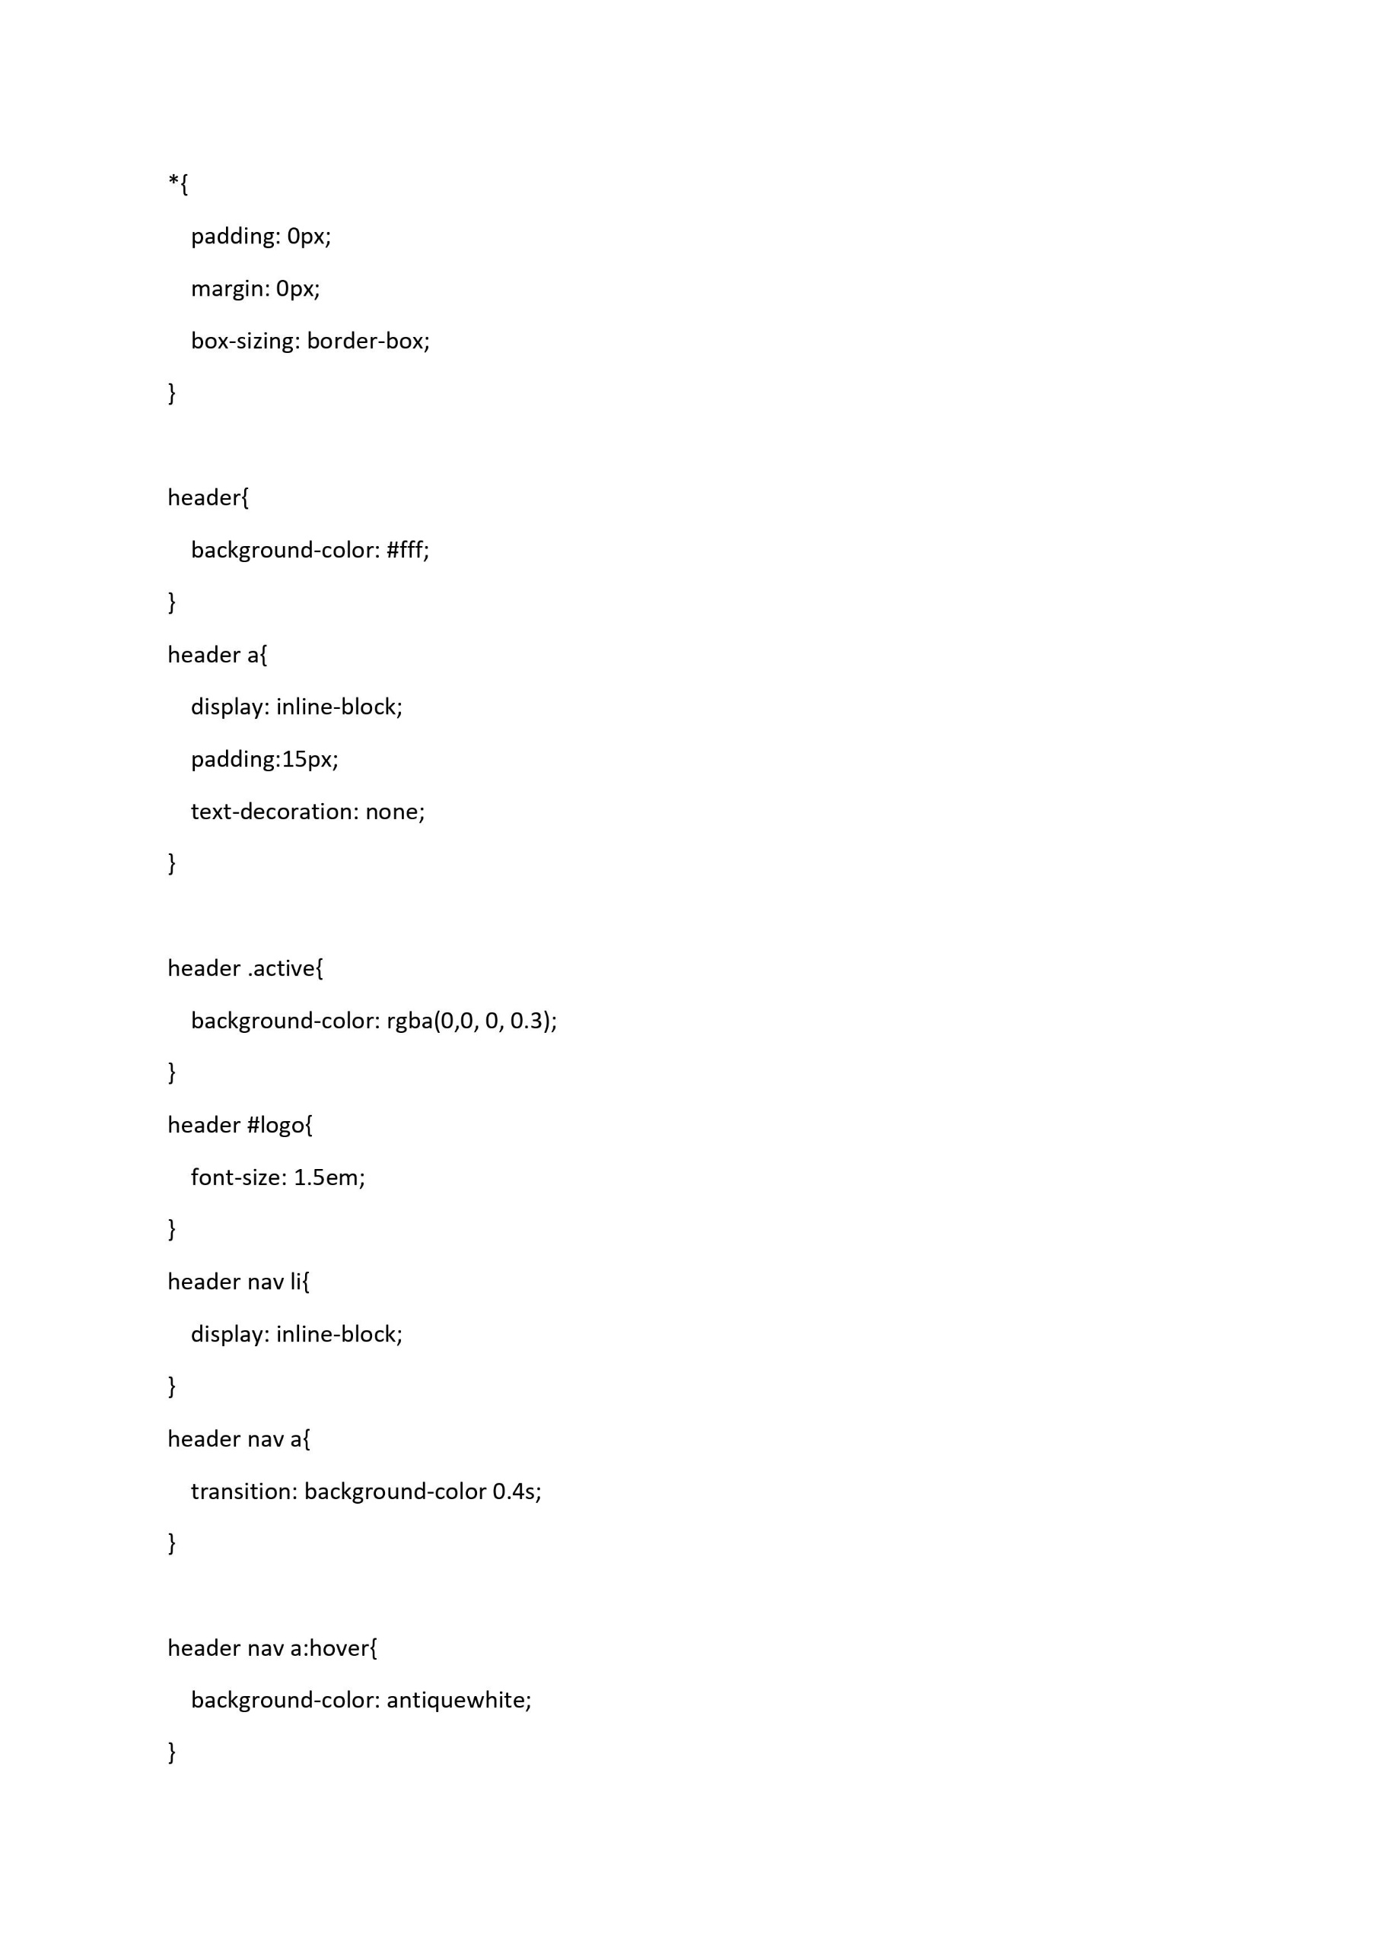

Slide 9
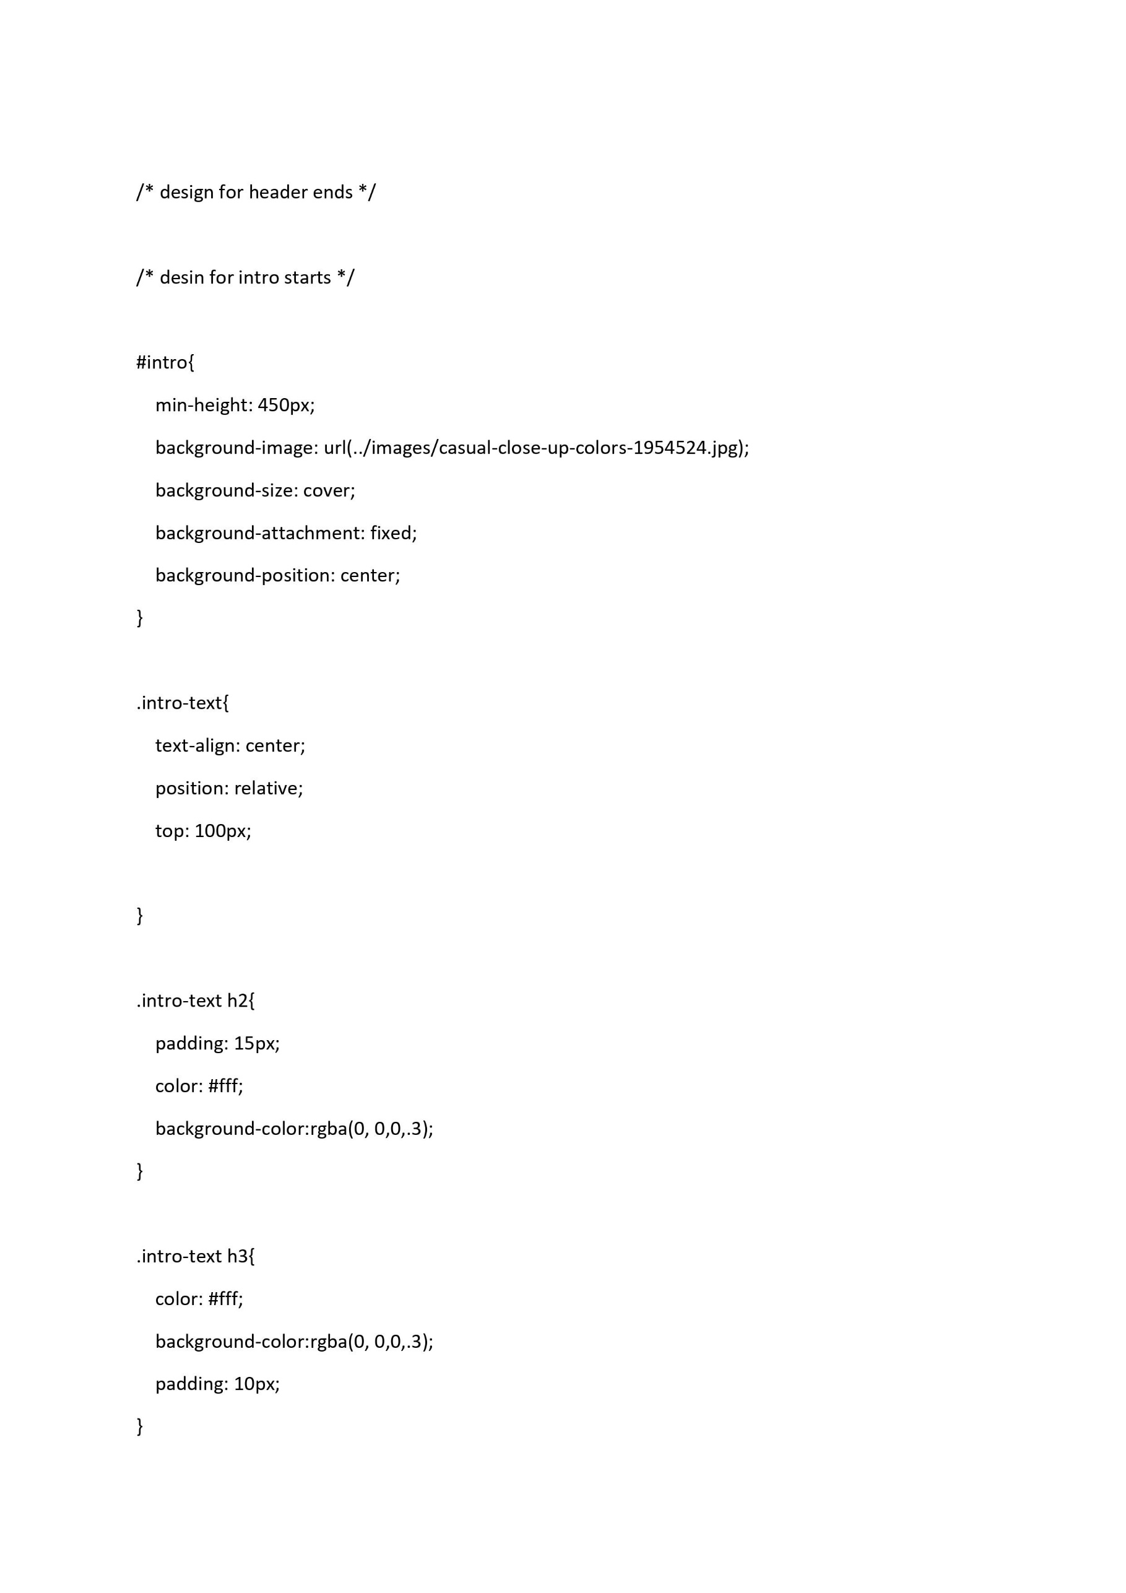

Slide 10
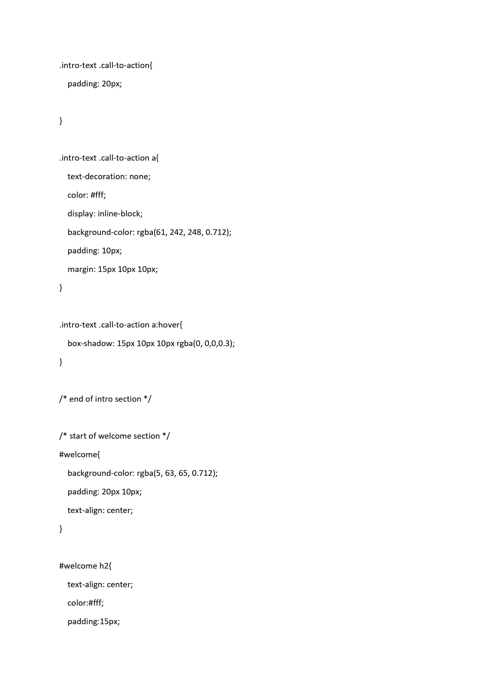

Slide 11
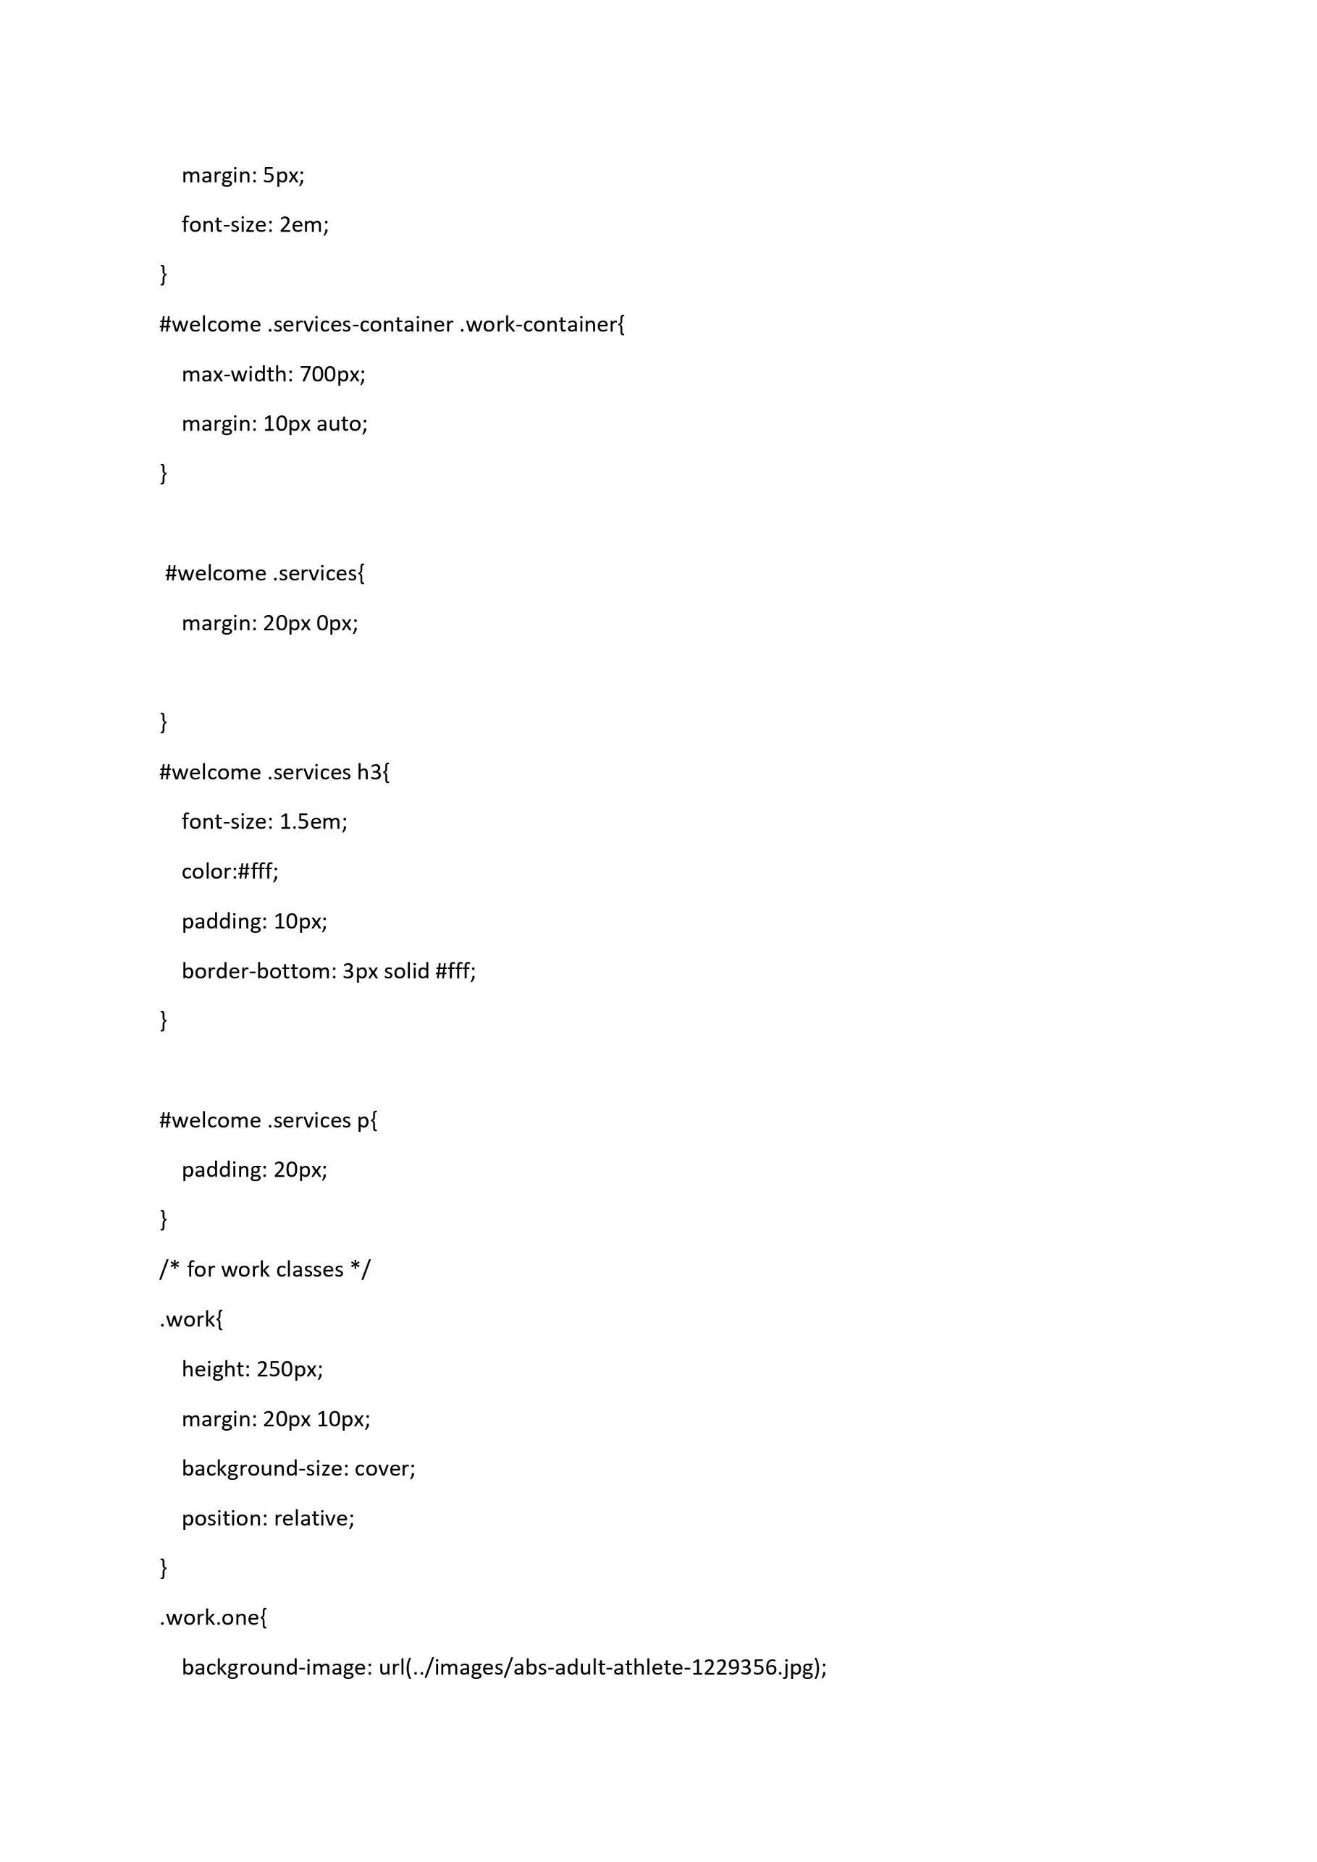

Slide 12
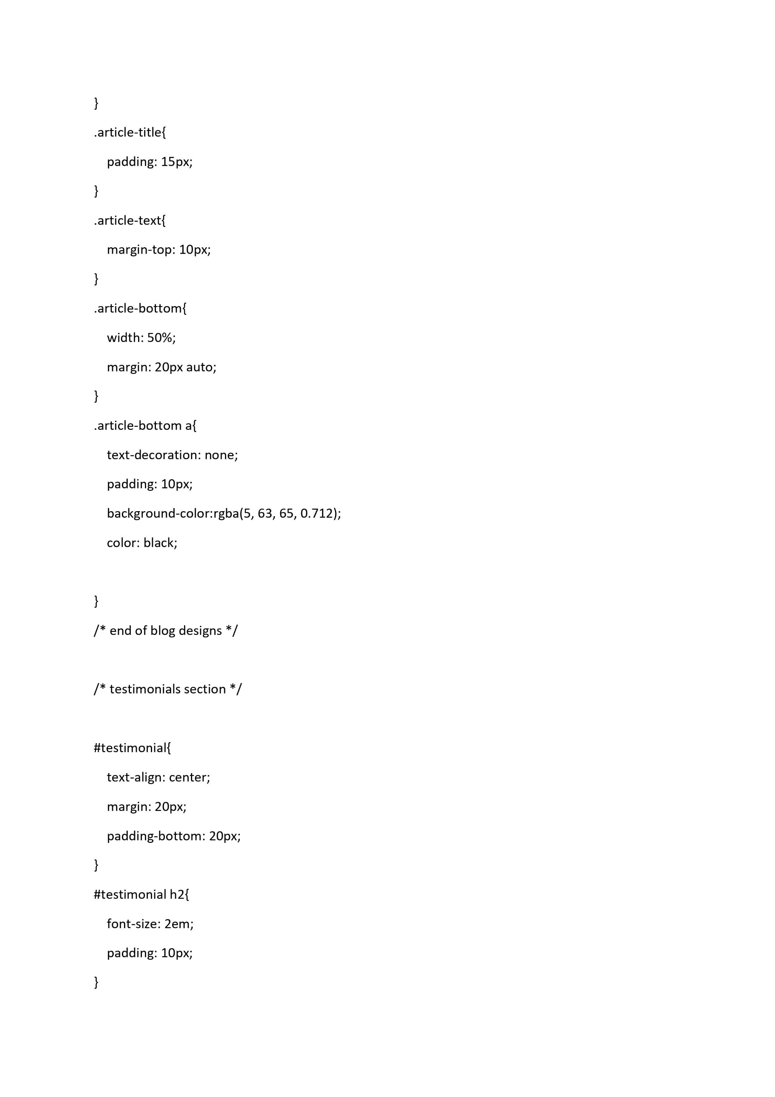

Slide 13
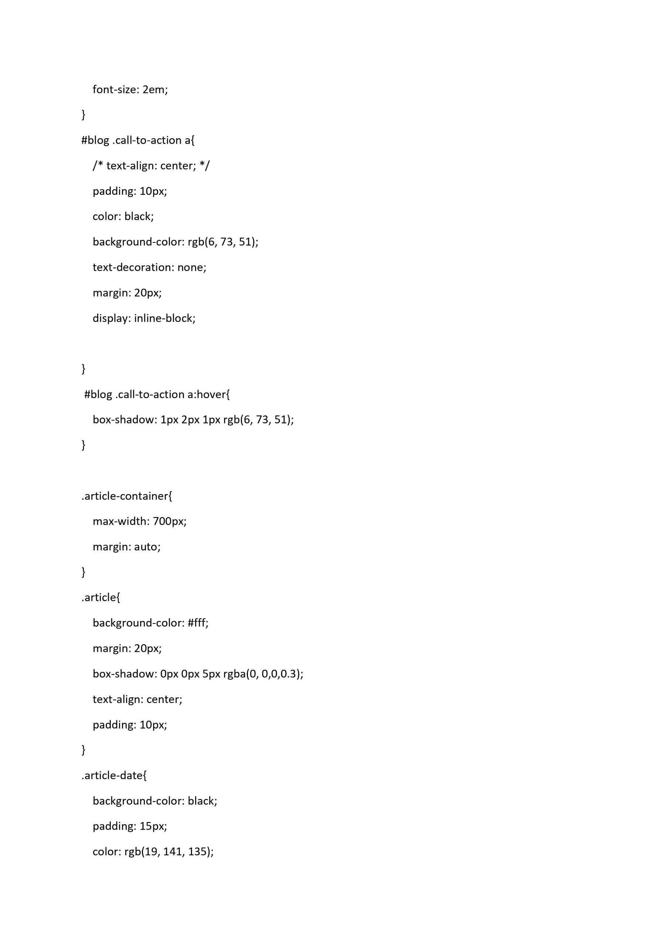

Slide 14
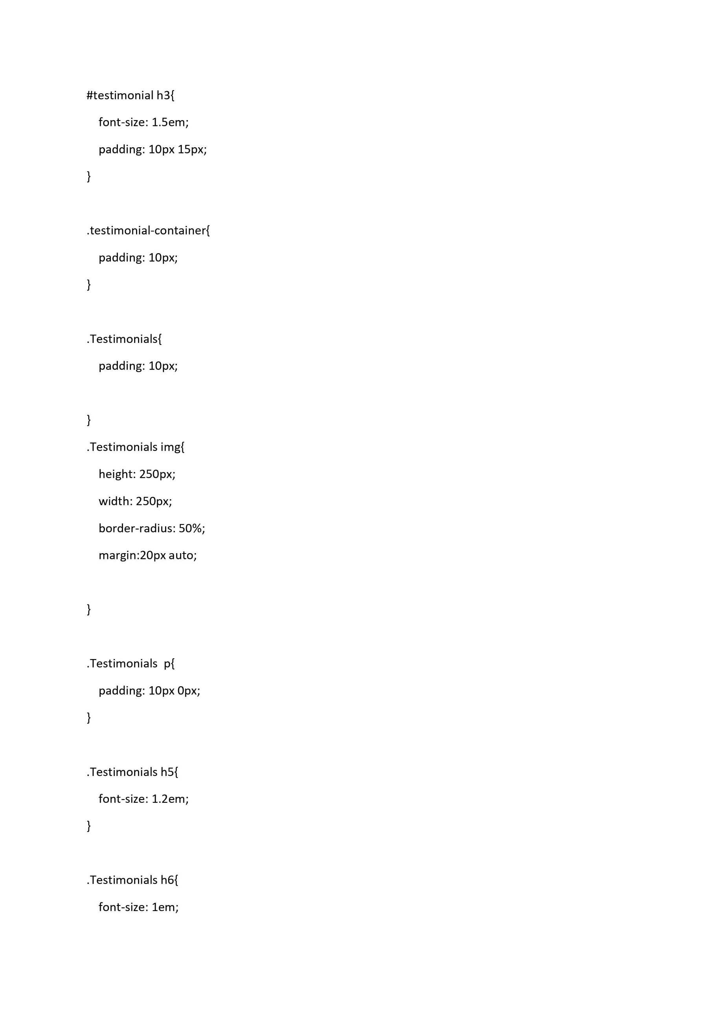

Slide 15
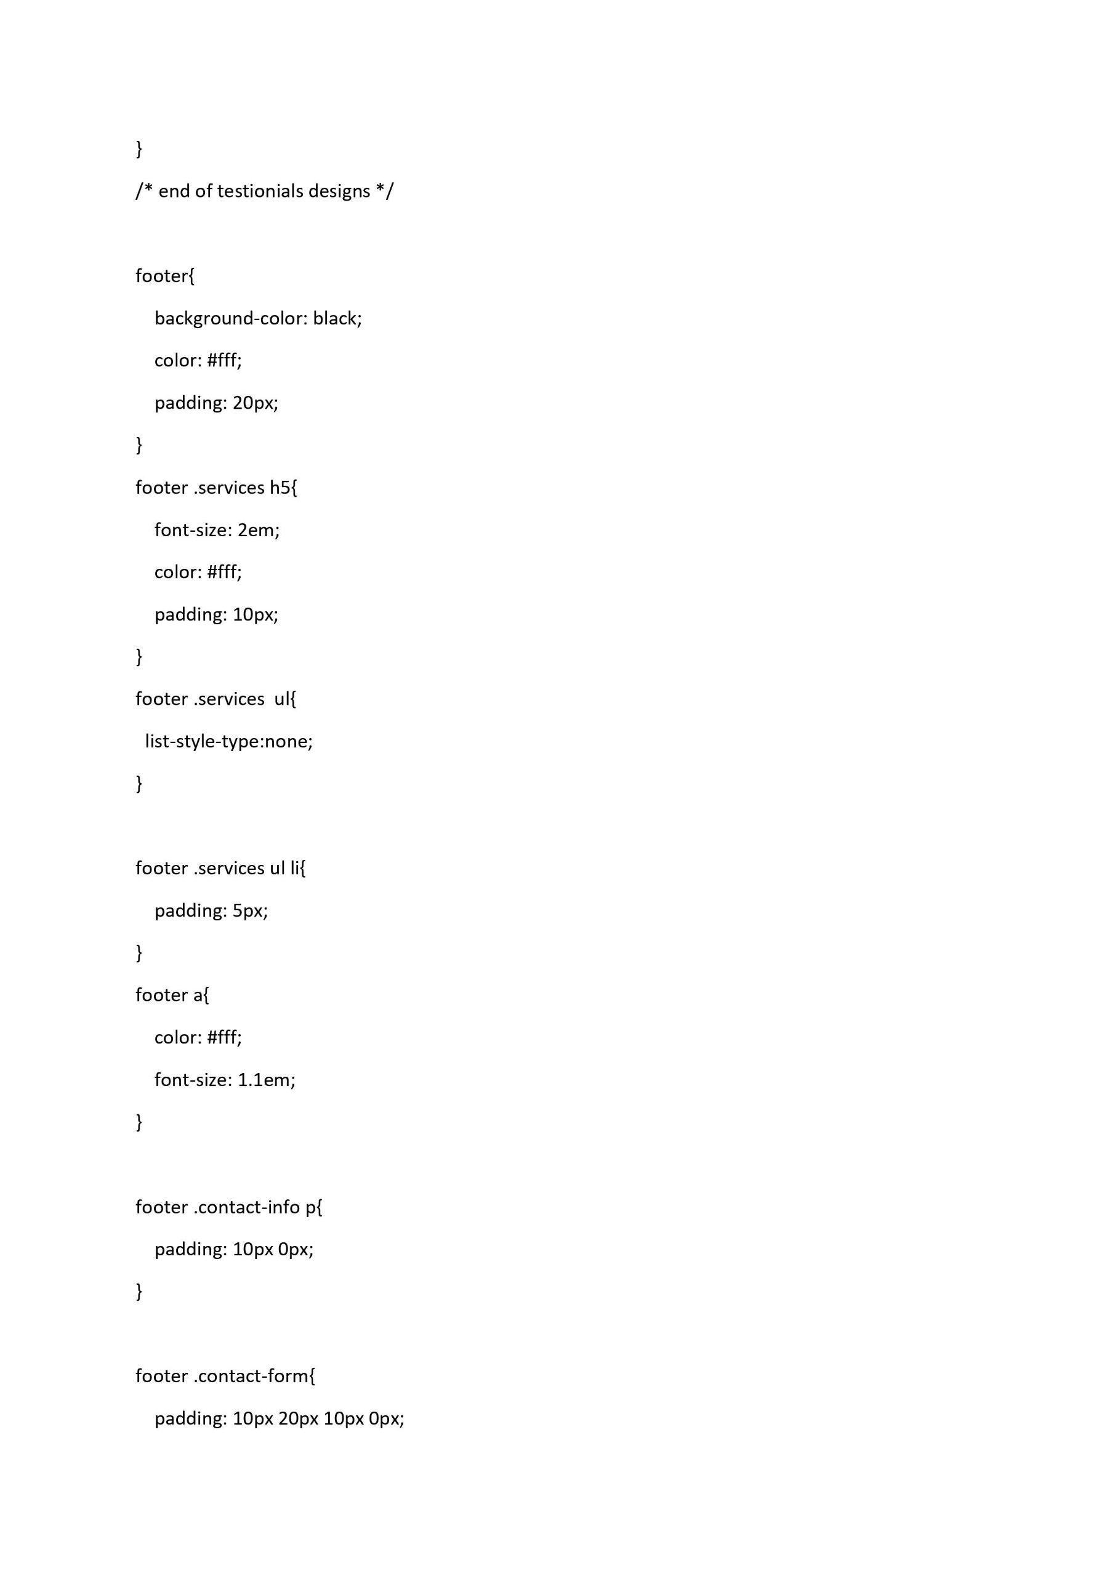

Slide 16
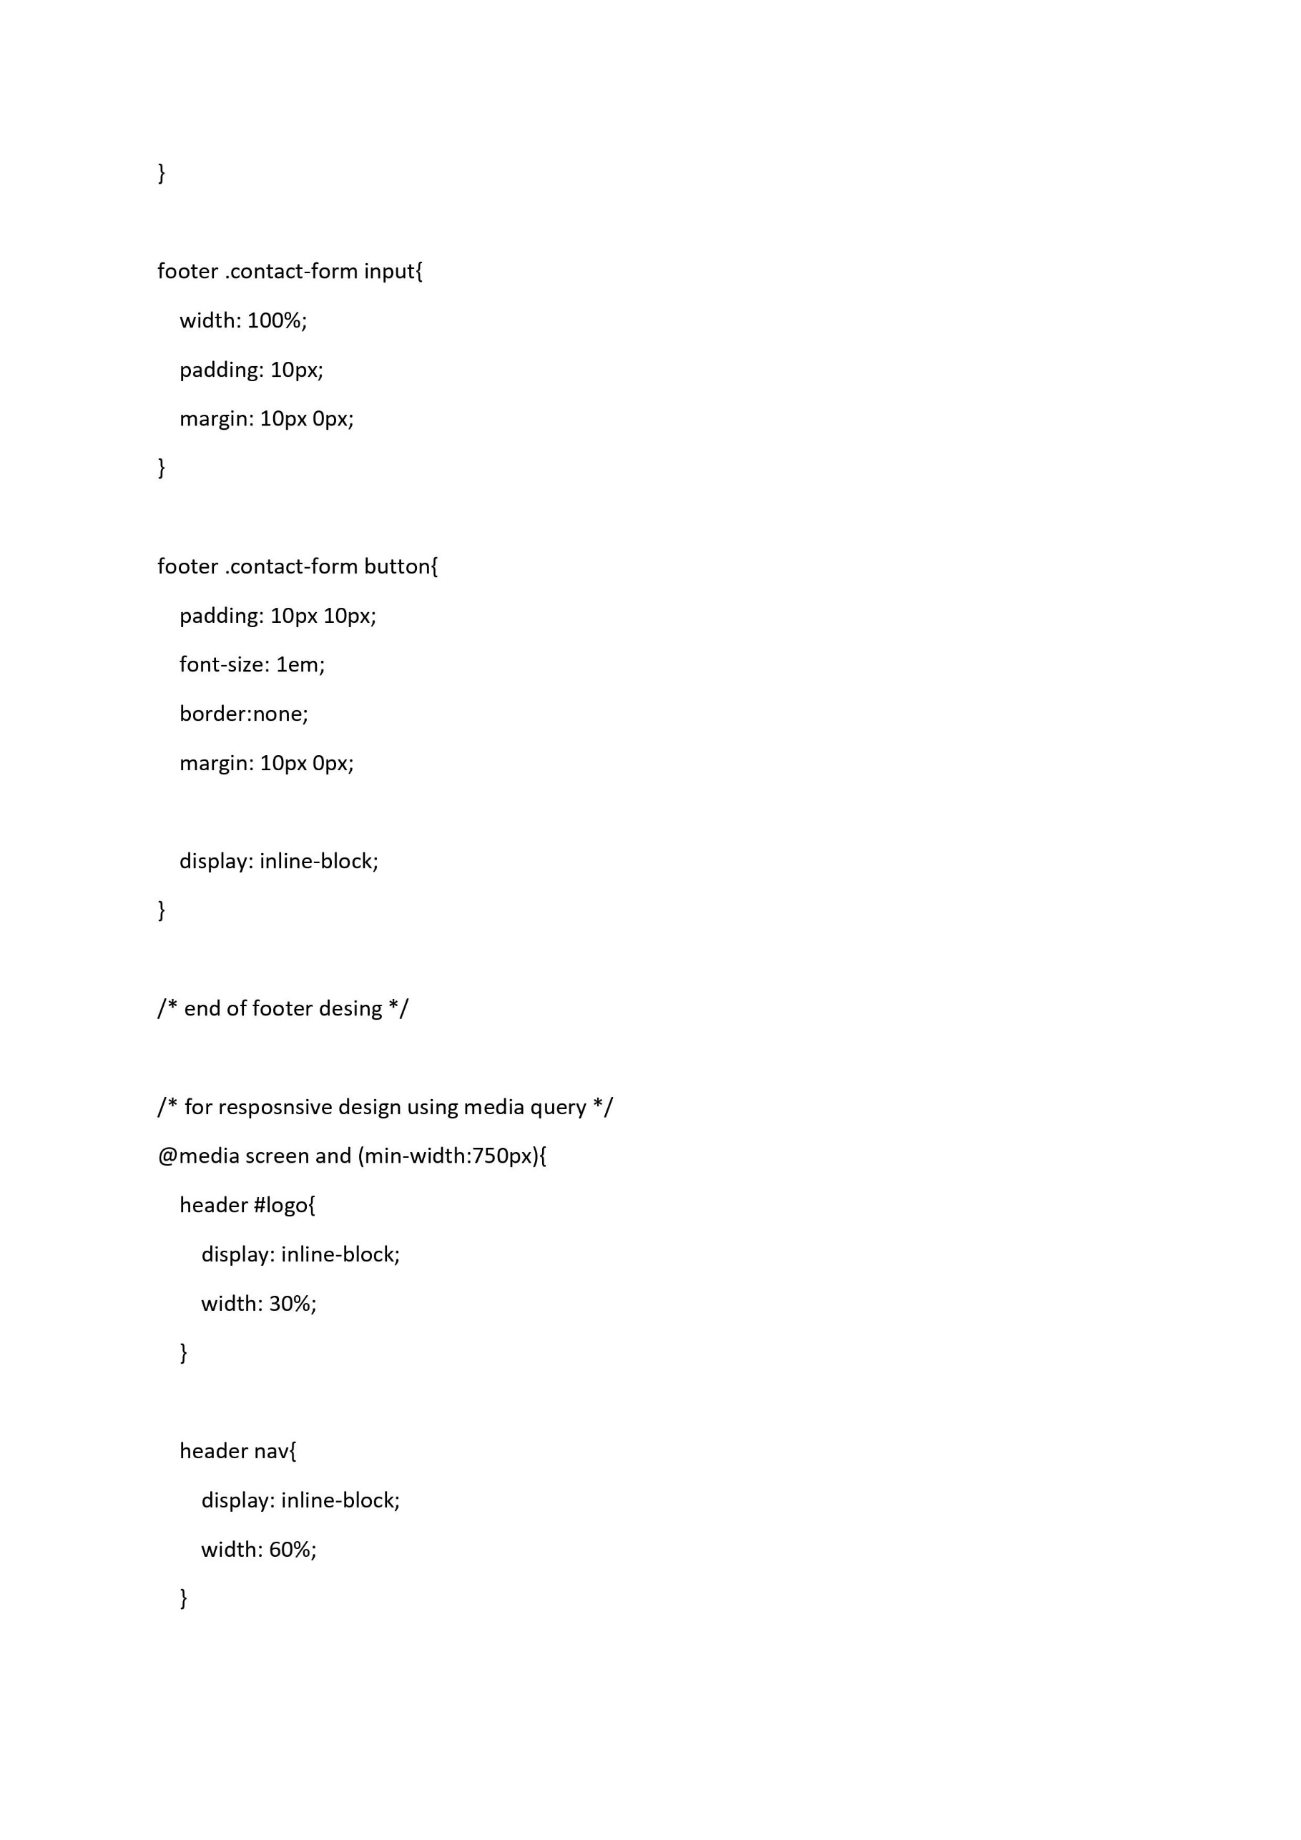

Slide 17
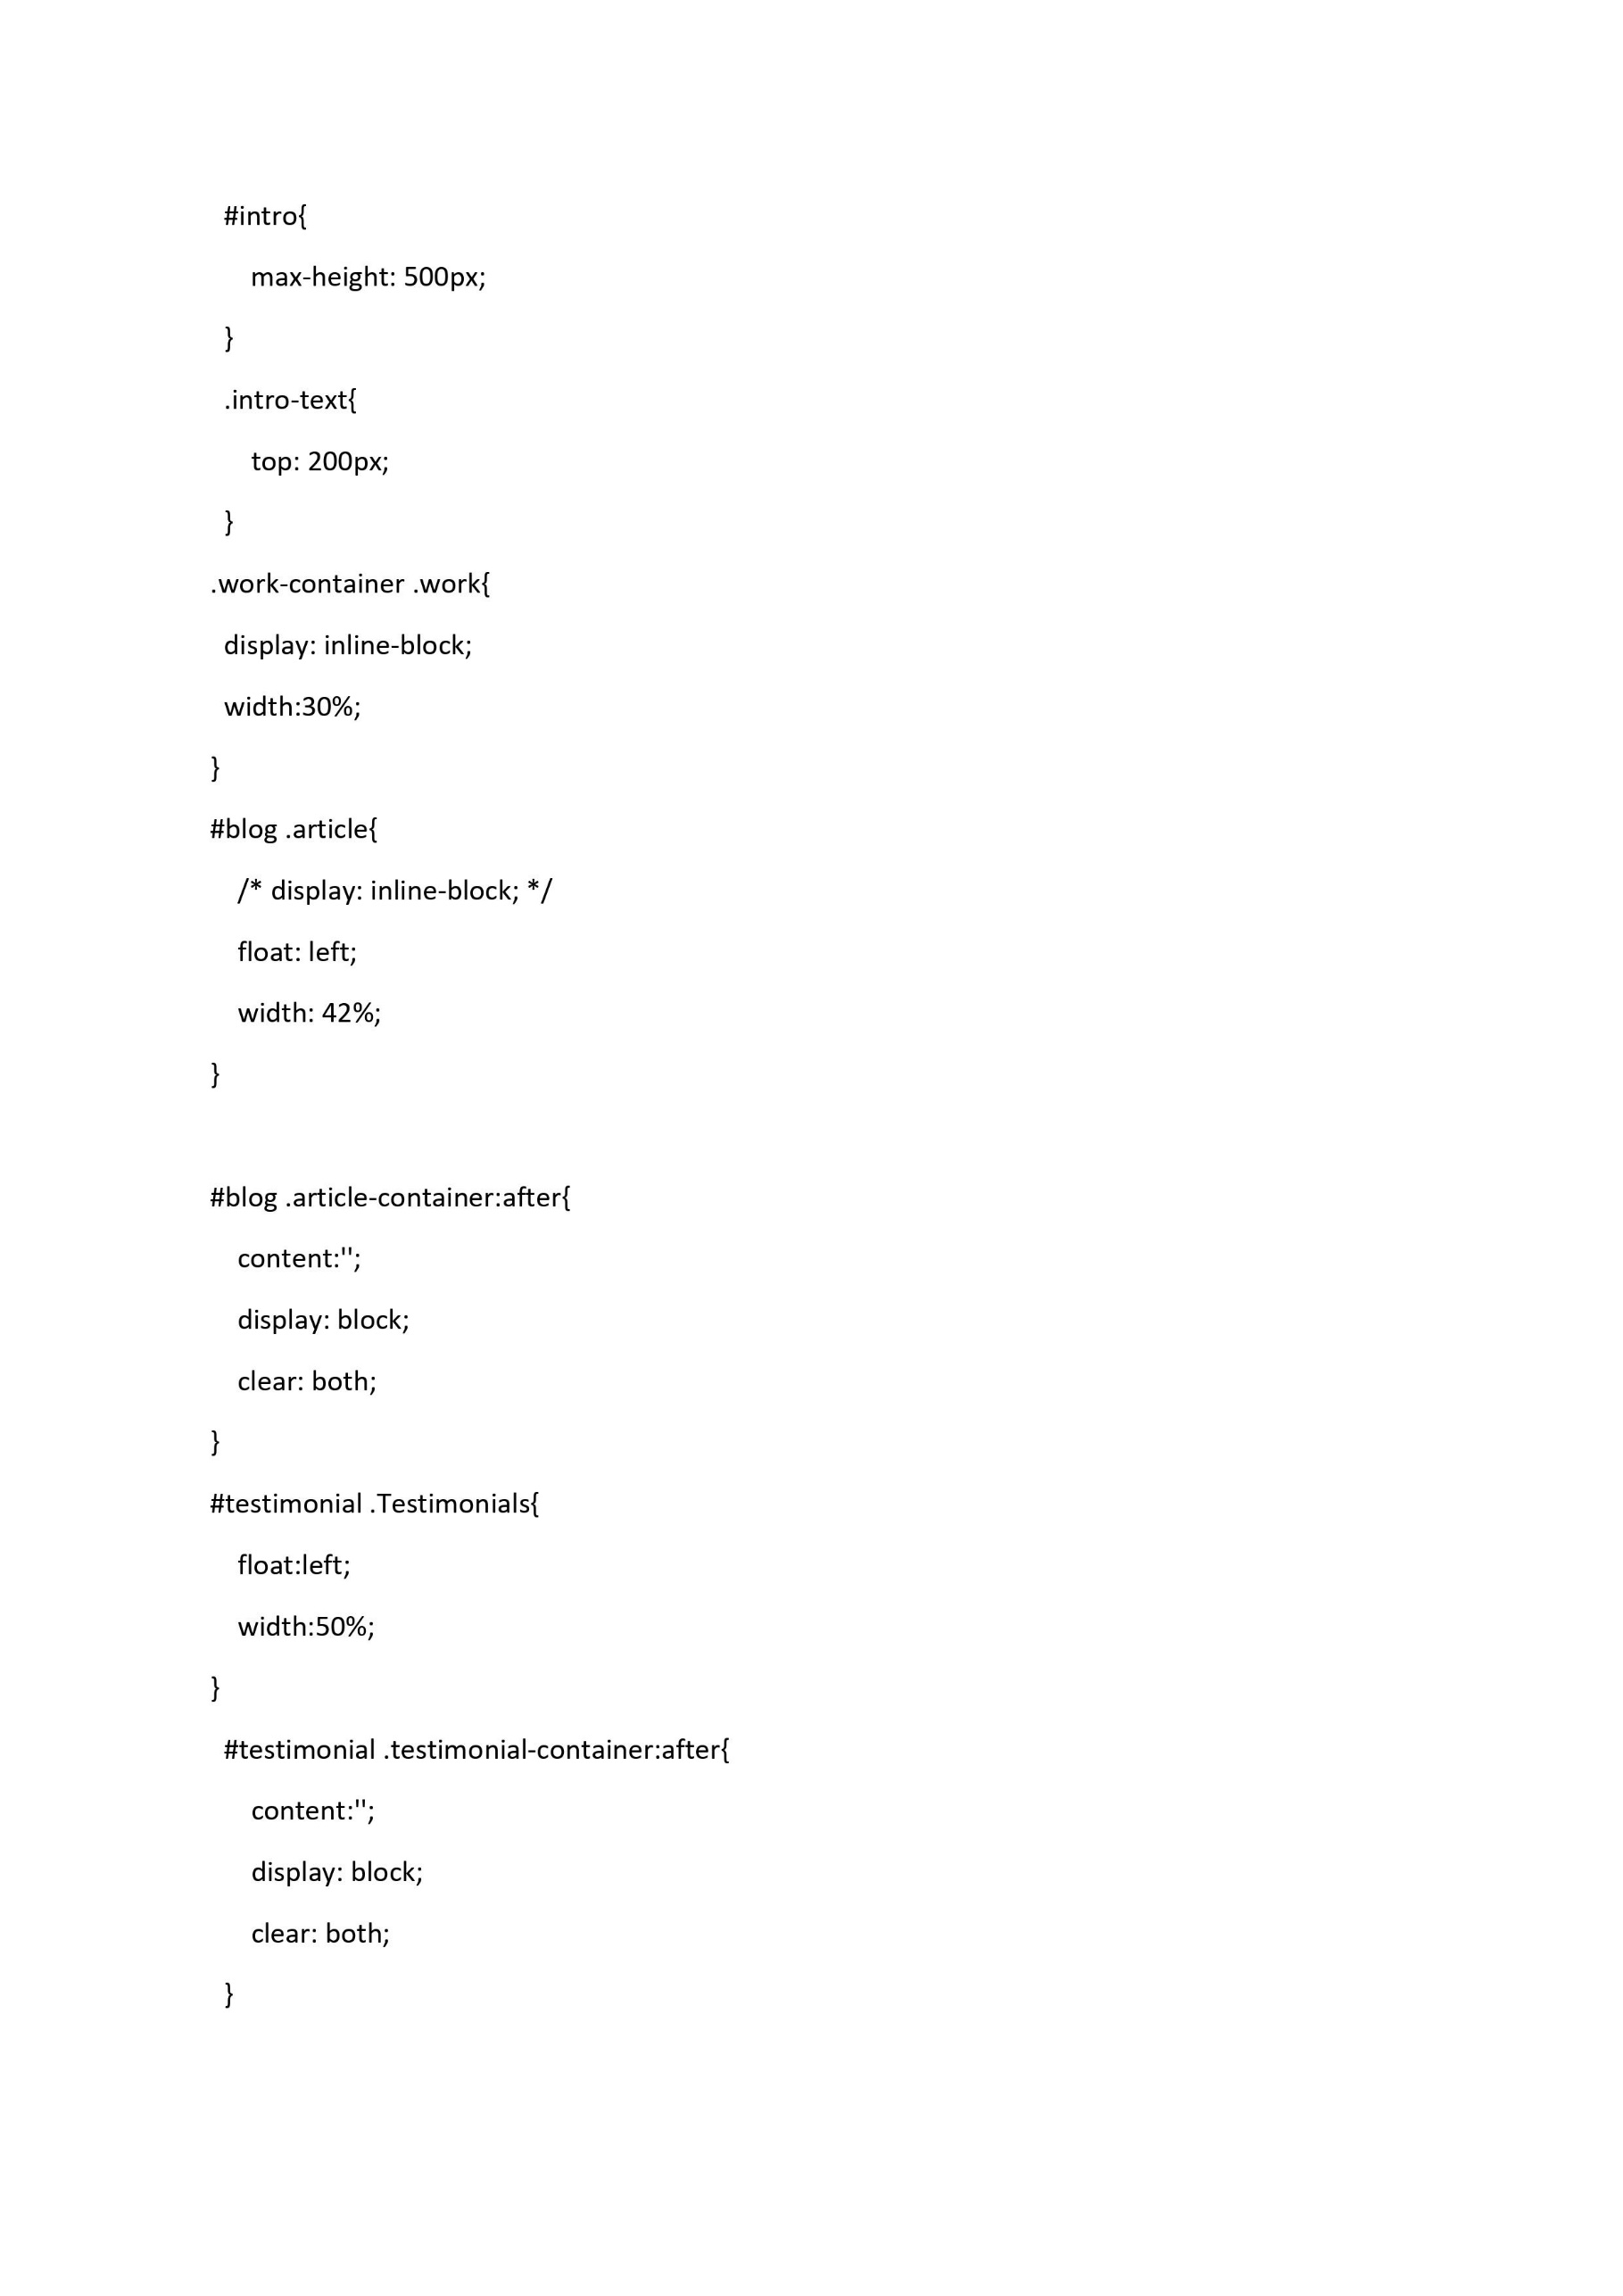
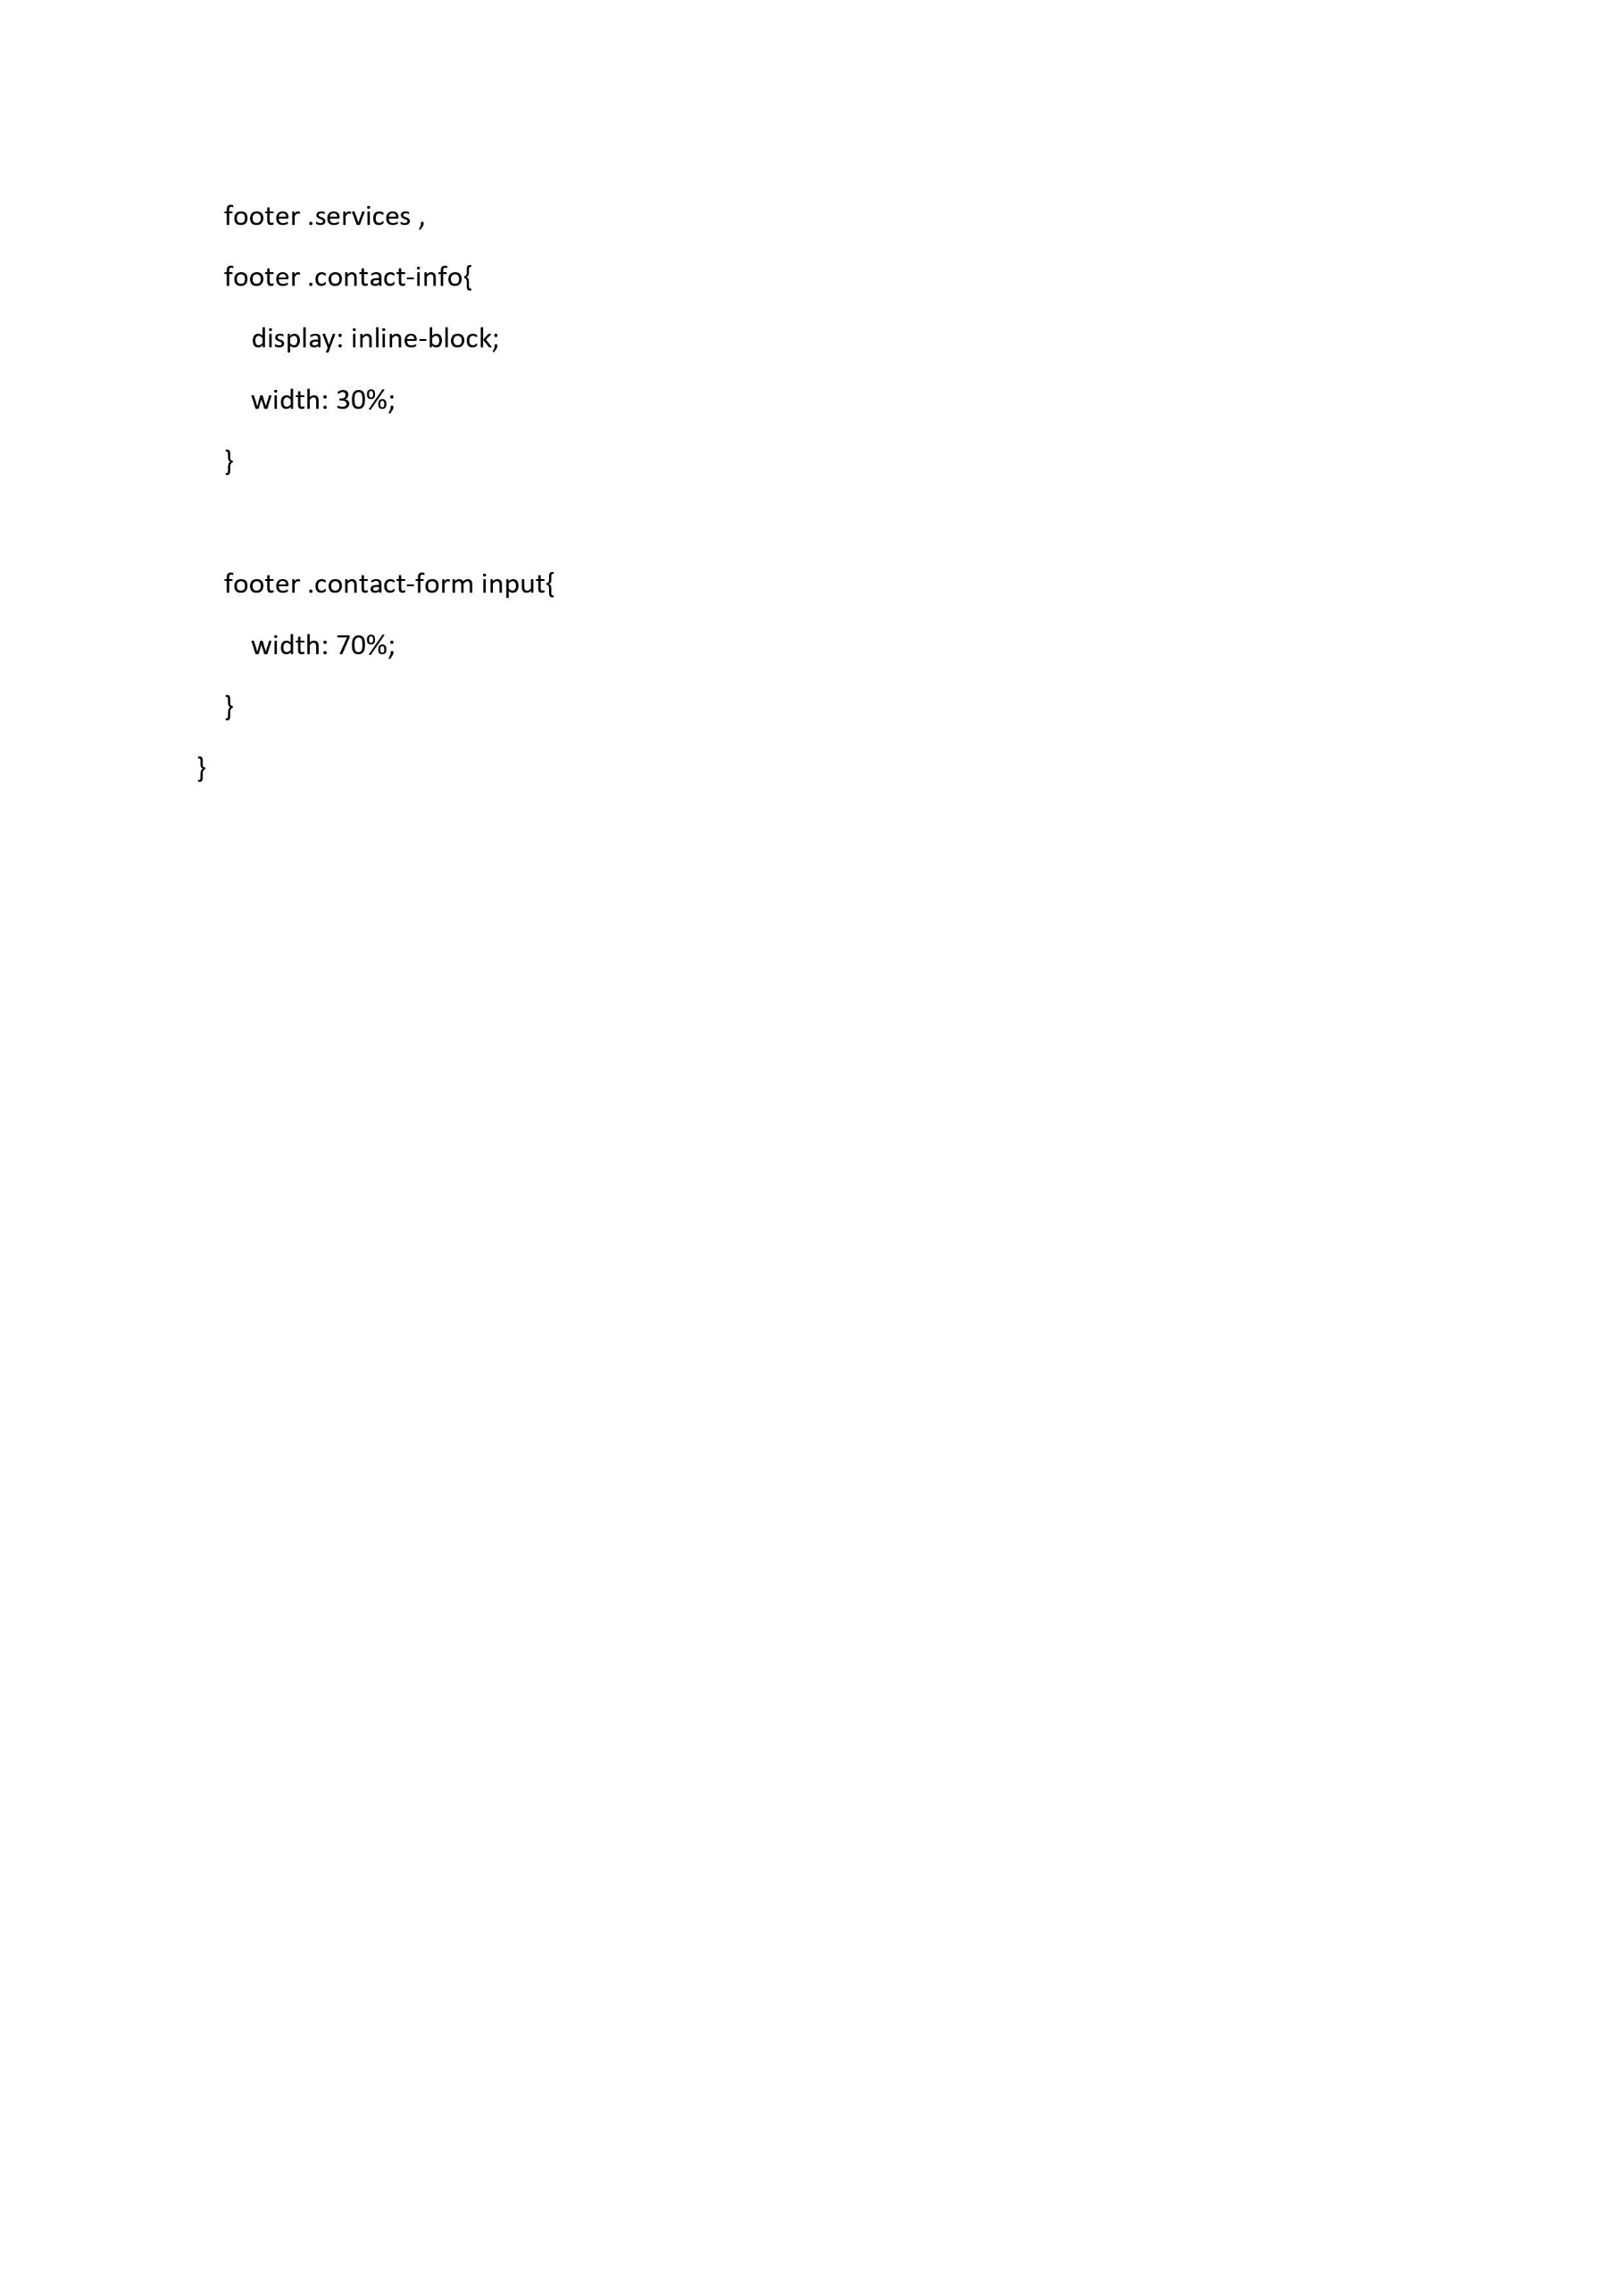

Slide 18
1)Overview in HTML/CSS
HTML (the Hypertext Markup Language) and CSS (Cascading Style Sheets) are two of the core technologies for building Web pages. HTML provides the structure of the page, CSS the (visual and aural) layout, for a variety of devices. Along with graphics and scripting, HTML and CSS are the basis of building Web pages and Web Applications. Learn more below about:
HTML is the language for describing the structure of Web pages. HTML gives authors the means to:
Publish online documents with headings, text, tables, lists, photos, etc.
Retrieve online information via hypertext links, at the click of a button.
Design forms for conducting transactions with remote services, for use in searching for information, making reservations, ordering products, etc.
Include spread-sheets, video clips, sound clips, and other applications directly in their documents.
With HTML, authors describe the structure of pages using markup. The elements of the language label pieces of content such as “paragraph,” “list,” “table,” and so on
CSS is the language for describing the presentation of Web pages, including colors, layout, and fonts. It allows one to adapt the presentation to different types of devices, such as large screens, small screens, or printers. CSS is independent of HTML and can be used with any XML-based markup language. The separation of HTML from CSS makes it easier to maintain sites, share style sheets across pages, and tailor pages to different environments. This is referred to as the separation of structure (or: content) from presentation.

Slide 19
2)About this project
It is a console based FITNESS CENTER.
From this we can save contact info like first name, last name,gmail.
We also can see , modify, send message.
It is made by HTML/CS.
It is easy to use.

Slide 20

SYSTEM REQUIREMENT
Hardware Required:
Operating System: Windows 98, 2000, XP , Vista, 7, 8,
8.1, 10, 11
Memory: 512 Mb RAM
Header file used:
#include<conio.h>
Storage: 60 Mb
Software Required:
GCC Version 9.2.0
#include<string.h>
#include<stdlib.h>
Command Prompt
#include<windows.h>
Visual Studio Code
Technique Used:
HTML/CSS
File Handling

Slide 21
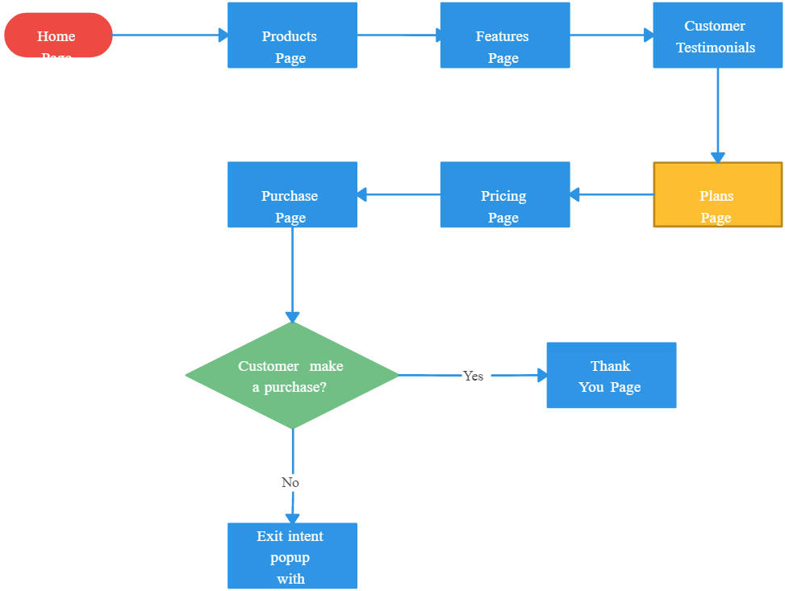
FLOW CHART

Slide 22
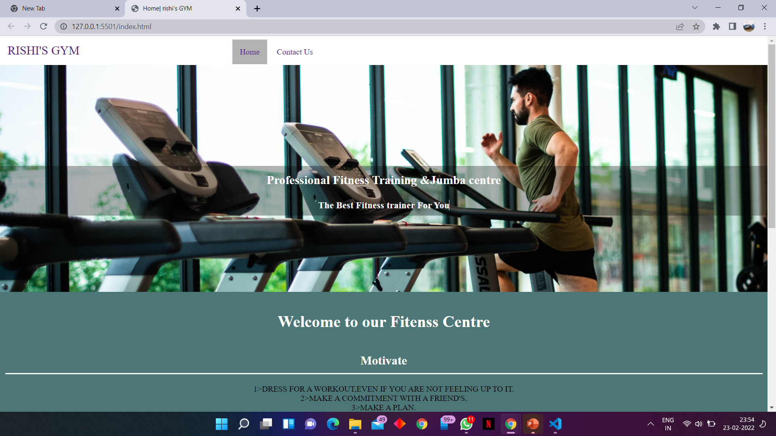

Slide 23
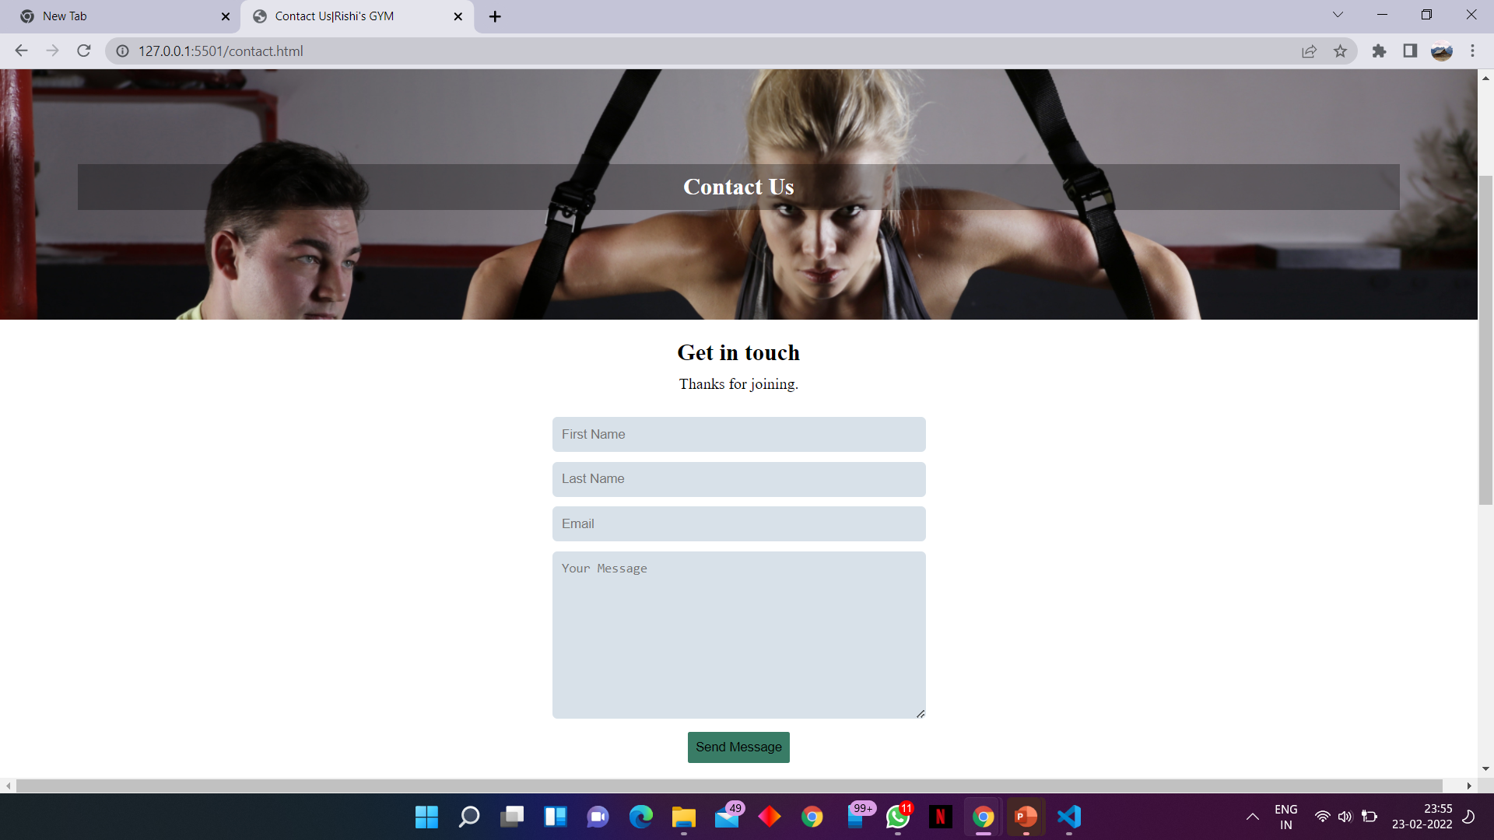

Slide 24
Conclusion
In past, when technology is not evolved it is difficult to manage phone directory by this program we can easily save and read phonebook
This is console base RISHI’S FITNESS CENTER
system made in HTML\CSS

